Slide 1
Project Name: MedicalCycle Cloud
Presented by: Eko Gedeon LAGLOIRE
Role: CEO & Project Lead, MedicalCycle Inc.

Slide 2
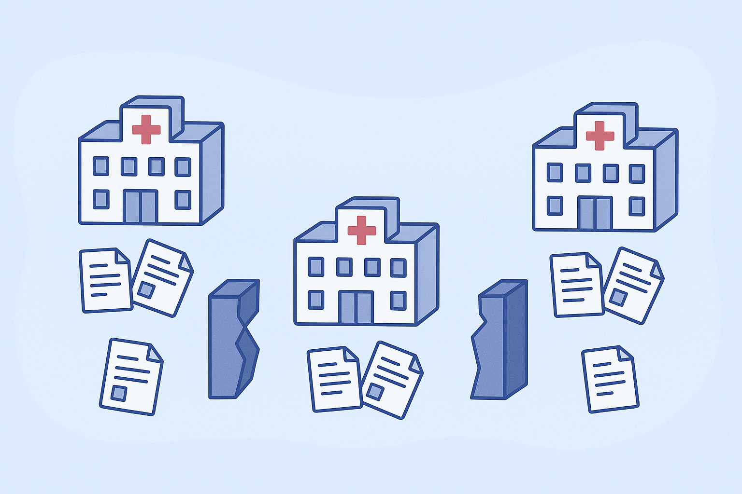
SLIDE 2 — Problem Description
The problem:
In many healthcare systems, hospitals and clinics store patient data separately.
This causes:
Lack of data continuity between institutions.
Repeated medical tests and errors.
Delays in diagnosis or treatment.
Data loss due to poor record management.

Slide 3
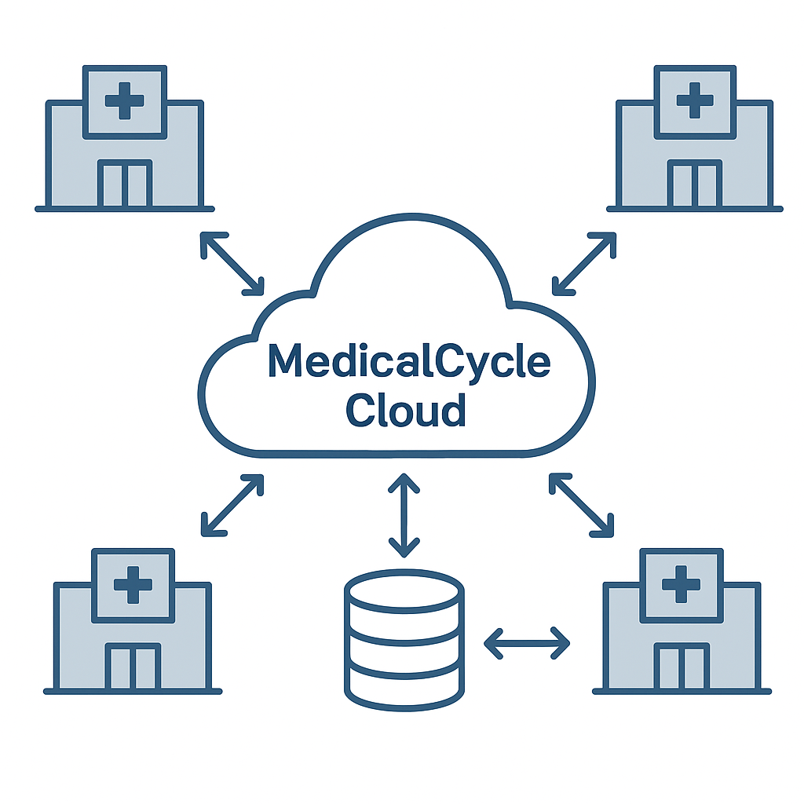
SLIDE 3 — Project Description
MedicalCycle Cloud is a cloud-based distributed platform that connects hospitals, clinics, and pharmacies.
It allows them to:
Access and share patient records securely.
Update information in real-time.
Collaborate on medical decisions remotely.
It aims to build a connected medical ecosystem using cloud computing and distributed systems.

Slide 4
SLIDE 4 — Project Scope & Justification
Scope:
Hospitals, clinics, and pharmacies are the main users.
Each can create, edit, and view patient records through the cloud.
Doctors and pharmacists collaborate via a unified interface.
Justification:
Enables continuity of care across institutions.
Reduces duplication and data loss.
Increases efficiency and reliability through distributed storage.
Supports scalability and fault tolerance for critical healthcare operations.

Slide 5
SLIDE 5 — Agenda of Construction Activities
Step | Activity | Description
1 | Planning | Identify key stakeholders & requirements
2 | System Design | Define cloud architecture & database replication
3 | Development | Create web interface & backend APIs
4 | Testing | Simulate hospital connections & fault recovery
5 | Deployment | Deploy on cloud servers
6 | Evaluation | Measure performance, reliability, scalability

Slide 6
SLIDE 7 — Expected Impact
Improved data accessibility for healthcare professionals.
Reduced delays and duplication of tests.
Stronger collaboration among hospitals.
Reliable, continuous healthcare delivery.
(Ajoute une image de patients ou d’un réseau hospitalier connecté.)

Slide 7
SLIDE 8 — ConclusionMedicalCycle
Cloud demonstrates how cloud and distributed systems can revolutionize healthcare data management.It provides a scalable, fault-tolerant, and collaborative solution to one of the most critical challenges in modern medicine: data fragmentation.“Connecting hospitals, saving time, saving lives.”

